Slide 1
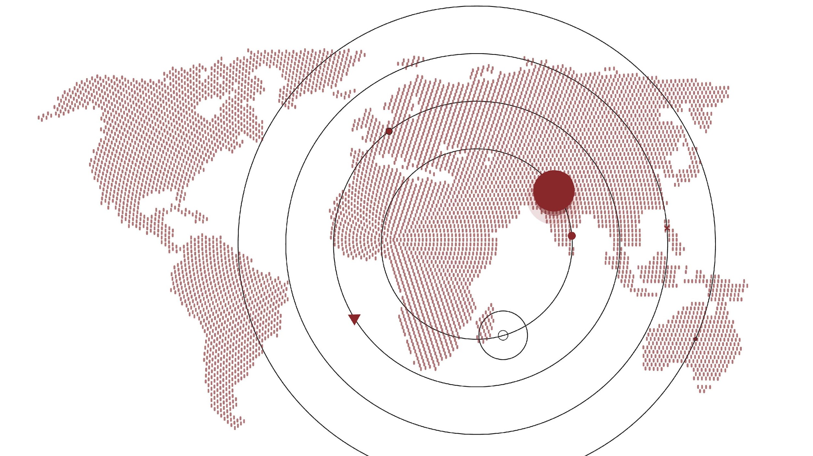




Productivity Calculator App
BY-
DRIZZLE
YASH
ADITYA
EVA
SATYA

Slide 2

Contents
Introduction
Aim
Purpose
Features
Benefits
Functionalities
Future update
Compatibility
Conclusion

Slide 3

Introduction
The ProductivityCalculator App is a Java application that helps users track their productive hours in a day. With this app, users can easily add, update and delete routine tasks in the list. This app is designed to help individuals manage their time effectively and increase productivity.
The app has a simple and user-friendly interface that allows users to quickly navigate through its features. Whether you are a student, freelancer or working professional, the ProductivityCalculator App can help you stay on top of your daily tasks and achieve your goals.

Slide 4

Aim of this app
The aim of the Productivity Calculator app is to help individuals track and manage their daily routine tasks in order to increase productivity. The app allows users to add, update, and delete tasks, as well as track the time spent on each task. By providing users with a clear picture of how they are spending their time, the app can help them identify areas where they can improve and optimize their productivity. Additionally, by providing a summary of their productive hours, the app can serve as a motivational tool, encouraging users to maintain or improve their productivity over time. Overall, the aim of the app is to help individuals become more efficient and effective in their daily lives.

Slide 5

Purpose of app
The purpose of the Productivity Calculator app is to help individuals become more productive by allowing them to track their daily routine tasks and calculate how many productive hours they have in a day. With the ability to add, update, and delete tasks in the list, users can easily customize their routine to best fit their needs. By using this app, users can gain a better understanding of how they are spending their time and make adjustments to increase their productivity. Additionally, the app can serve as a motivation tool to encourage users to stick to their routine and make the most out of their day.

Slide 6

Features of app
The system ask user to enter user name and password. On successful login, System asks to create a task List for the logged user.
ii. The system asks user to enter an option from the selected list of operations(Add, Update, Delete)
Adding tasks to the list with the name and duration in minutes.
Updating tasks in the list by specifying the task number, new name, and duration in minutes.
Deleting tasks from the list by specifying the task number.
Displaying all the tasks in the list along with their respective durations.
iii. The user can enter the routine tasks, category(Productive/Non-Productive) and the hours the task takes to get accomplished.
Upon segregation of essential but non-productive tasks, the user needs to calculate the number of productive hours he is left with.
Calculation of the total productive hours from the durations of all the tasks in the list.
The code implements all the above features using ArrayLists for storing the tasks and durations, and a Scanner class for taking user inputs from the console.
The code also includes a login system to ensure the privacy and security of the tasks.

Slide 7
Benefits of app
Helps individuals track and manage their daily routine tasks
Encourages users to focus on productivity by displaying the total number of productive hours in a day
Provides a simple and user-friendly interface for adding, updating, and deleting tasks
Enables users to prioritize tasks and allocate time accordingly
Reduces mental overload by organizing tasks into a manageable list
Encourages consistency by helping users establish daily routines
Increases accountability by keeping track of completed tasks
Provides a sense of accomplishment and motivation by highlighting completed tasks and productive hours
Enables users to identify inefficiencies in their daily routines and make adjustments as necessary
Facilitates better time management and increases overall productivity.

Slide 8
Functionalities
Login: The user is prompted to enter their login details to access the app.
Add Task: The user can add a new task to their routine by entering the task name and duration in minutes.
Update Task: The user can update an existing task by entering the task number to update, the new task name, and the new duration in minutes.
Delete Task: The user can delete an existing task by entering the task number to delete.
Display Tasks: The user can view all the tasks in their routine along with their durations.
Calculate Productive Hours: The app calculates the total productive hours based on the sum of durations of all the tasks in the user's routine.
Exit: The user can exit the app when they are done using it.

Slide 9
Future updates and development plans
User authentication: Currently, the app requires users to enter a username and password to access it, but there is no authentication process to ensure that the correct credentials are entered. Adding an authentication mechanism, such as two-factor authentication or OAuth, would increase the app's security.
Data persistence: Currently, the app does not store tasks or their durations once the program is closed. Adding a database or file system to persist data would allow users to close and reopen the app without losing their task list.
Task categorization: Users may want to categorize their tasks based on type, priority, or due date. Adding the ability to categorize tasks and sort them based on these criteria would improve the user experience.
Notifications: Users may want to receive notifications when a task is due or when a task has been updated or deleted. Adding notification functionality would improve the app's usability.
Integration with other apps: Users may want to integrate this app with other productivity tools they use, such as calendars or to-do lists. Adding integration capabilities would increase the app's versatility and usefulness.
User interface improvements: Currently, the app has a simple command-line interface. Adding a graphical user interface (GUI) would make the app more user-friendly and visually appealing.

Slide 10
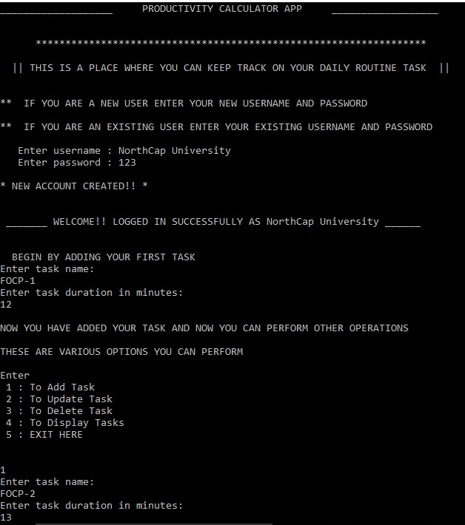
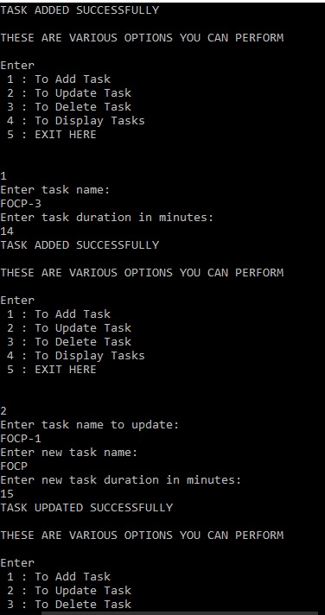
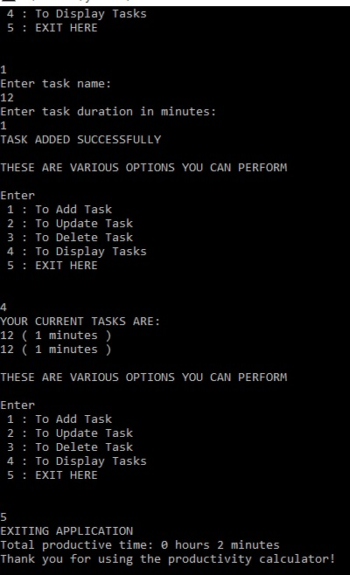

Slide 11
Compatibility
The Productivity Calculator App is written in Java and is compatible with any device that has a Java Runtime Environment (JRE) installed, which includes most desktop computers, laptops, and servers.
The app can be compiled and run using a Java development environment such as Eclipse, IntelliJ IDEA, NetBeans, or Visual Studio Code with the appropriate Java extensions installed. The code can also be compiled and run using the command line, provided that a Java Development Kit (JDK) is installed on the system.
Therefore, the app can be run on platforms that support Java, including Windows, Linux, and macOS, using a variety of development environments, text editors, and command-line tools.
However, the user needs to have basic knowledge of Java and be comfortable working with the command line interface. The app requires a keyboard and screen for input and output. It may not be compatible with mobile devices or other devices that do not support Java.

Slide 12
Conclusion
In conclusion, the Productivity Calculator app is a useful tool for anyone looking to improve their productivity and manage their time effectively. With its simple and intuitive interface, users can easily add, update, and delete tasks in a list, as well as view the total productive hours they have achieved in a day.
The app provides a range of features to enhance productivity, including the ability to set reminders, prioritize tasks, and track progress over time. Users can also customize the app to suit their individual needs, such as by setting their own productivity goals or creating different task categories.
Overall, the Productivity Calculator app is a valuable tool for anyone looking to improve their time management skills and achieve greater productivity in their daily lives. By using the app to track their progress and stay focused on their goals, users can take control of their time and achieve more in less time.

Slide 13
Thank you

